Slide 1
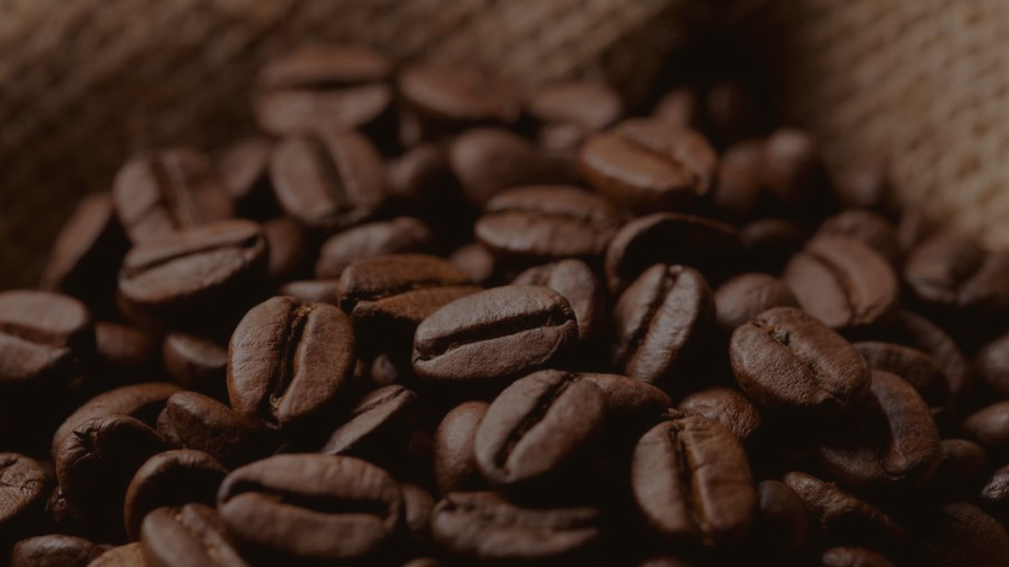
BRIGHT LEARN COFFEE

Slide 2
Planning
1.
Sales
2.
Location Alloction
3.
Product
Perfomance

Slide 3
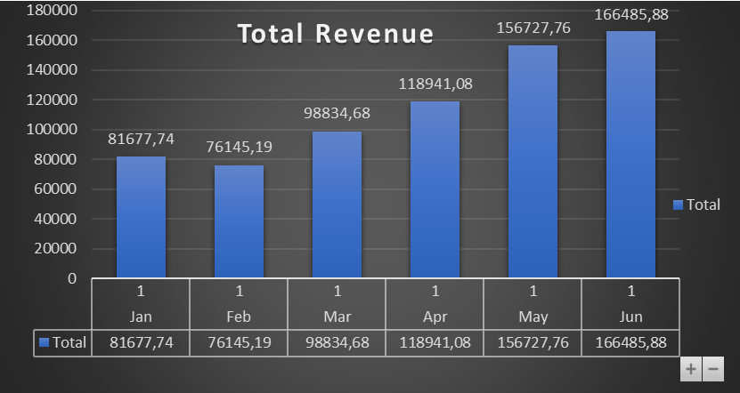
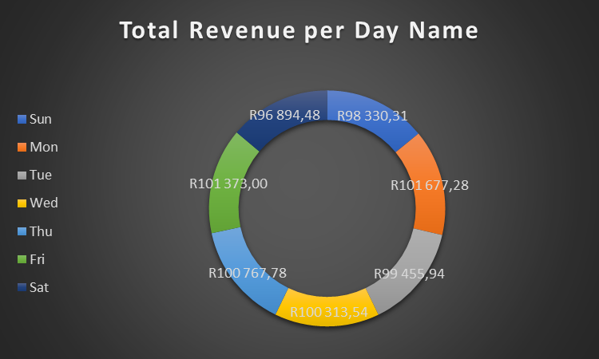
Sales
Each and everyday contributed very well in revenue even though there’s a slightly difference
Revenue of R698812,33 was generated throughout the 6 months phase.
All the months have displayed steady growth in revenue.
Notes:
.

Slide 4
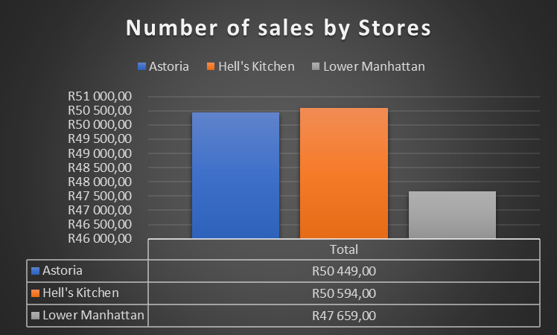
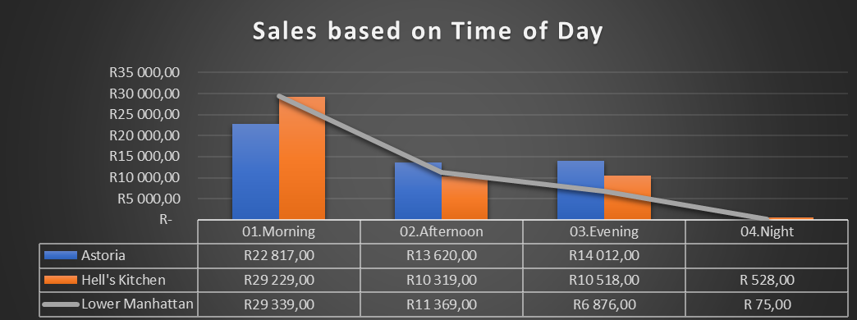
Sales indicated a clear decline: Morning sales generated 54,73% and Afternoon was 23,75% and Evening was 21,11% while Night dropped drastically to 0,41%.
Hell’s kitchen and Astoria have generated more sales 34% than Lower Manhattan 32%.

Slide 5
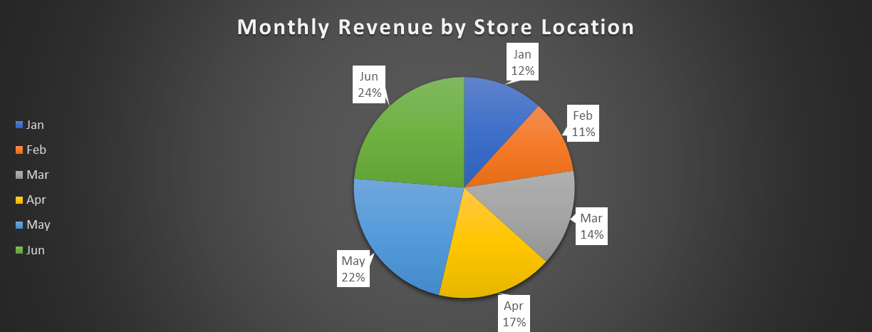
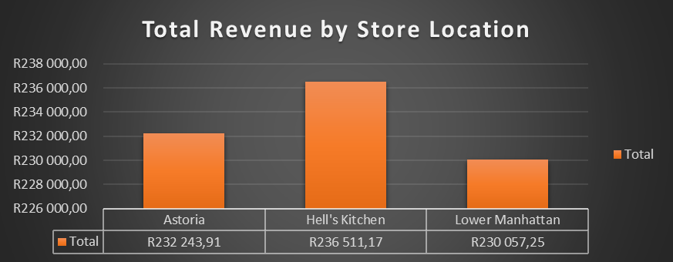
Location Allocation
The entire months showed a steady growth
Hell’s kitchen out-performed both Astoria and Lower Manhattan with a smaller difference
Notes:
.

Slide 6
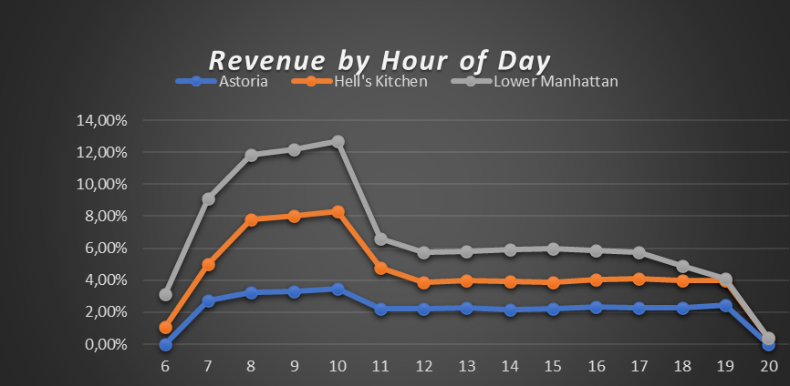
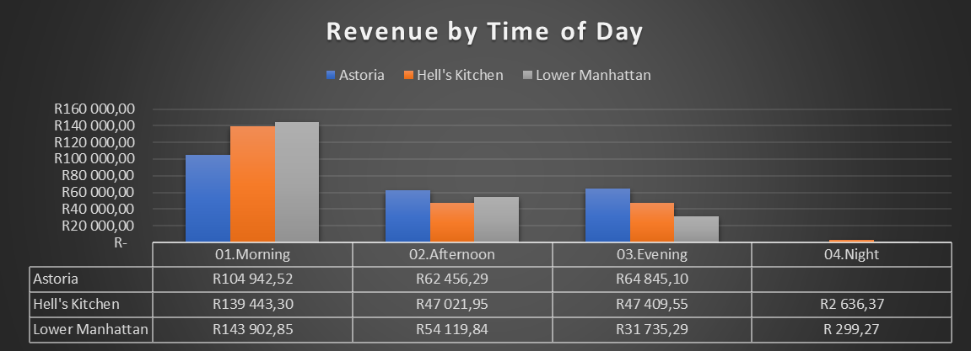
6am-10am Spiked to their highest revenue then 11am-18pm indicates a constant revenue while 19pm-20pm indicates a decline.

Slide 7
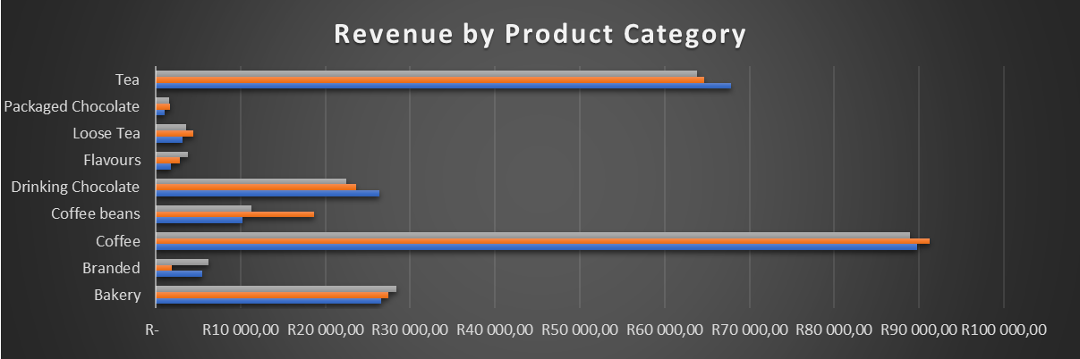
Product Performance
Coffee generated the most revenue which 38,63% while Tea was the second best with 28%

Slide 8




